Slide 1

GIS – Lab On Demand

Slide 2
GIS LOD Objective
Cost effective solution
Quick to setup & Easy to administer
Wide range of Applications
Elasticity
Anywhere accessibility
Demand based, easy spin-up and spin-down

Slide 3
Solution
AWS Platform
EC2 for IaaS
RDS for databases
Cloud Formation for templatization
Ops Works for Run Book Automation
GitHub as Template Repository
Front End application to manage Lab requests
Web Page to request Lab
Work Flow to manage approvals
Scheduler to deploy/ release Lab environments
API connectivity to AWS

Slide 4
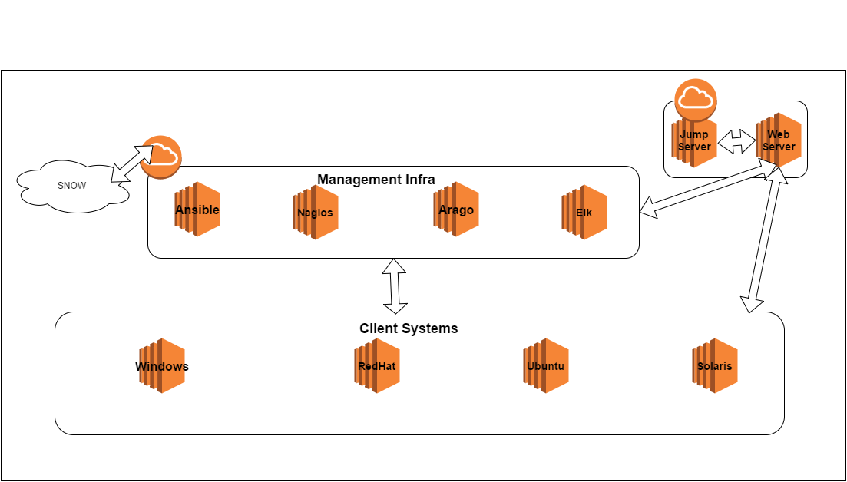
Tool Lab Architecture (For illustration)

Slide 5
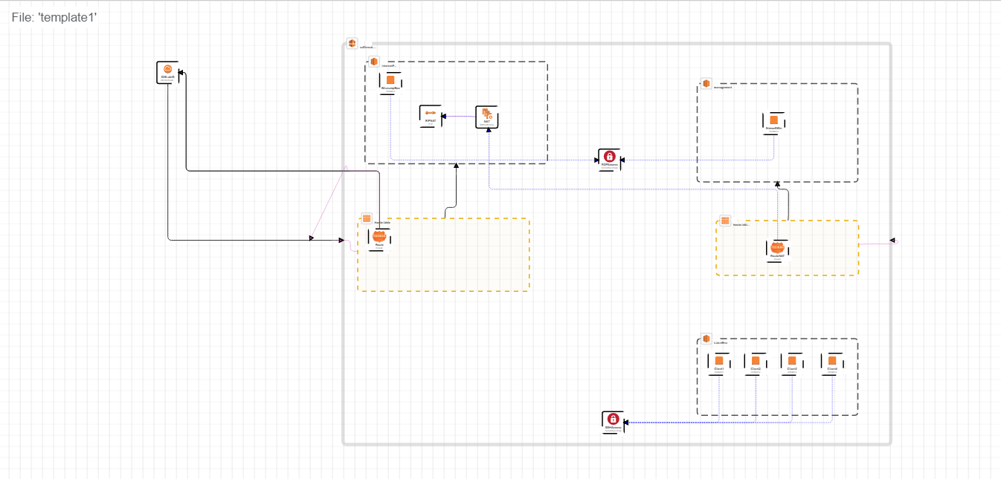
Cloud Formation Templatization

Slide 6
Thank you

